Slide 1


CS-482: Introduction to Blockchain and CryptoCurrency
Lecture # 6: Bitcoin Mining
Prof. Dr. Sufian Hameed
Department of Computer Science
FAST-NUCES
FAST-NUCES
Notes:
1

Slide 2
Recap: Bitcoin miners
Bitcoin depends on miners to:
Store and broadcast the block chain
Validate new transactions
Vote (by hash power) on consensus
But who are the miners?
Notes:
But what rules?

Slide 3
The task of Bitcoin miners

Slide 4
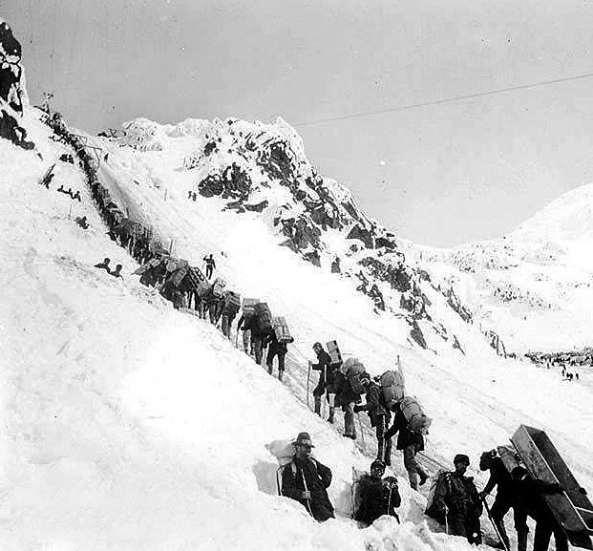
So you want to be a miner?
Gold miners ascending the Chilkoot pass
Klondike gold rush of 1898
Notes:
Image is public domain (Wikimedia commons)

Slide 5
Mining Bitcoins in 6 easy steps
Join the network, listen for transactions
Validate all proposed transactions
Listen for new blocks, maintain block chain
When a new block is proposed, validate it
Assemble a new valid block
Find the nonce to make your block valid
Hope everybody accepts your new block
Profit!
Useful to Bitcoin network
Notes:
Image is public domain (Wikimedia commons)

Slide 6
Finding a valid block
prev: H( )
prev: H( )
mrkl_root: H( )
mrkl_root: H( )
nonce: 0x0001...
nonce: 0x0002...
nonce: 0xffff...
nonce: 0x0000...
nonce: 0x0001...
nonce: 0xf77e...
nonce: 0x7a83
nonce: 0x0000...
hash: 0xd0c7...
hash: 0x6a1f...
hash: 0xc9c8...
hash: 0x300c...
hash:
hash: 0x0224...
hash: 0x0000...
hash:
hash: 0x0000
hash: 0x3485...
All changed
H( ) H( )
H( ) H( )
H( ) H( )
25.0→A
coinbase:
0x0000...00
25.0→A
coinbase:
0x0000...01
25.0→A
coinbase:
0x3df5...65
transaction
transaction
transaction
Notes:
Make sure to point out-coinbase is why miners aren’t all solving the exact same problem

Slide 7
Mining difficulty “target” (2014-08-07)
00000000000000003AAEA2000000000000000000000000000000000000000000
256 bit hash output
64+ leading zeroes required
Current difficulty = 2^{66.2}
=84,758,978,290,086,040,000

Slide 8
Setting the mining difficulty
Every two weeks, compute:
next_difficulty= previous_difficulty *
(2 weeks)/(time to mine last 2016 blocks)
Expected number of blocks in 2 weeks at 10 minutes/block

Slide 9
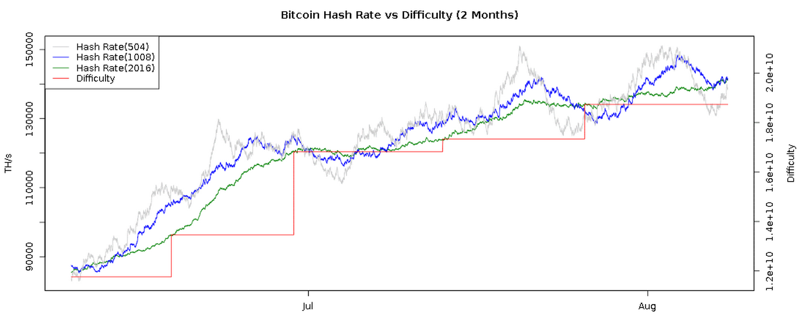
Mining difficulty over time
bitcoinwisdom.com

Slide 10
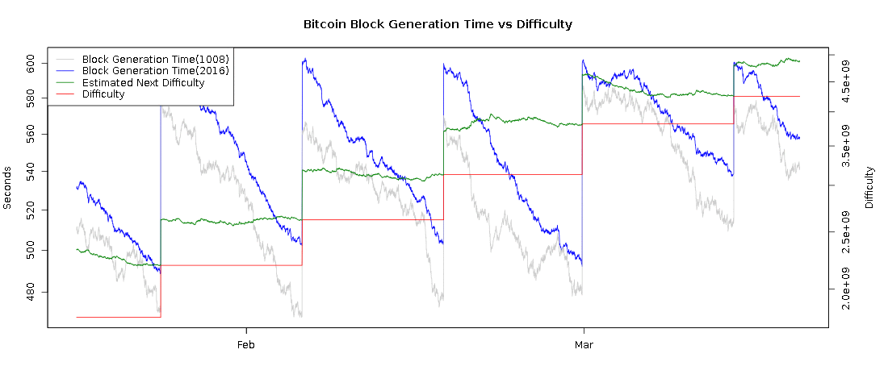
Time to find a block
10 minutes
2 weeks
bitcoinwisdom.com

Slide 11
Mining hardware

Slide 12
SHA-256
General purpose hash function
Part of SHA-2 family: SHA-224,SHA-384,SHA-512
Published in 2001
Designed by the NSA
Remains unbroken cryptographically
Weaknesses known
SHA-3 (replacement) under standardization
Notes:
Source: NIST standard (no copyright)

Slide 13
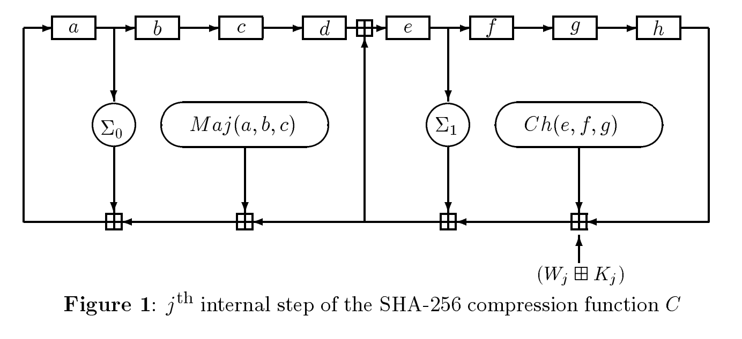
SHA-256 in more depth
256-bit state
Bitwise tweaks
x80 iterations
round constants
Addition mod 32
Notes:
Source: NIST standard (no copyright)

Slide 14
CPU mining
Using a SAT Solver to mine bitcoin
https://jheusser.github.io/2013/02/03/satcoin.html
while (1){
HDR[kNoncePos]++;
IF (SHA256(SHA256(HDR)) < (65535 << 208)/ DIFFICULTY)
return;
}
two hashes
Throughput on a high-end PC = 10-20 MHz ≈ 2²⁴
139,461 years to find a block today!

Slide 15
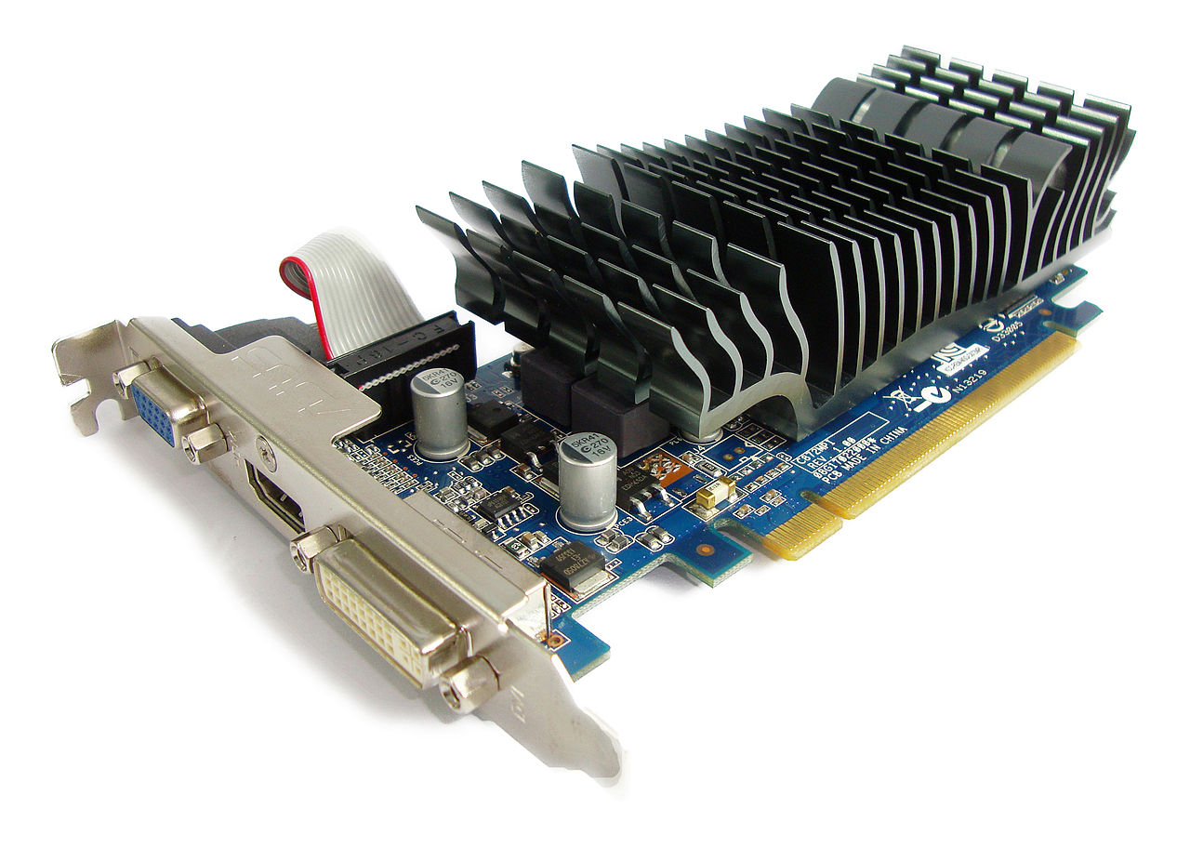
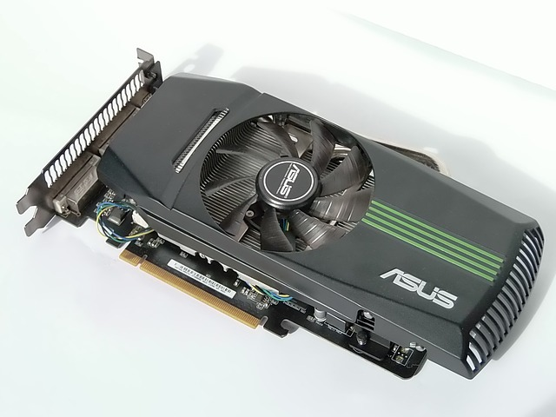
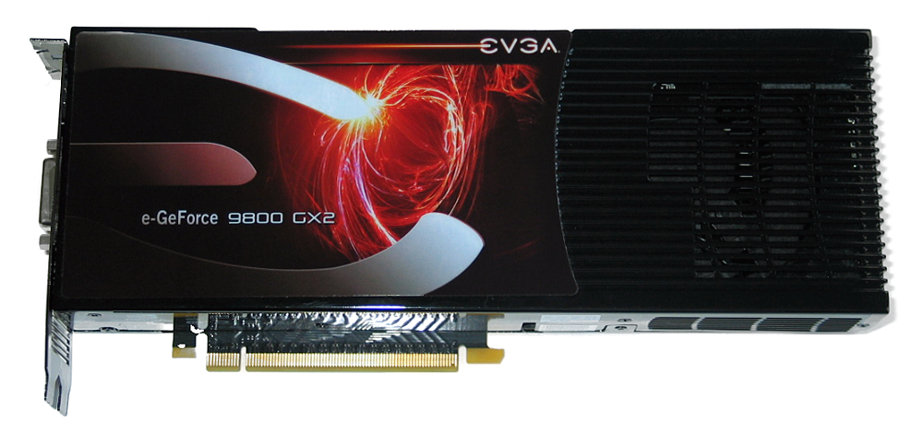
GPU mining
GPUs designed for high-performance graphics
high parallelism
high throughput
First used for Bitcoin ca. October 2010
Implemented in OpenCL
Later: hacks for specific cards

Slide 16
GPU mining advantages
easily available, easy to set up
parallel ALUs
bit-specific instructions
can drive many from 1 CPU
can overclock!
NVIDIA gpus are AWFUL at mining. ATI cards are great. Why?

Slide 17
“Goodput”
Observation: some errors are okay (may miss a valid block)
Goodput: throughput × success rate
Worth over-clocking by 50% with 30% errors!

Slide 18
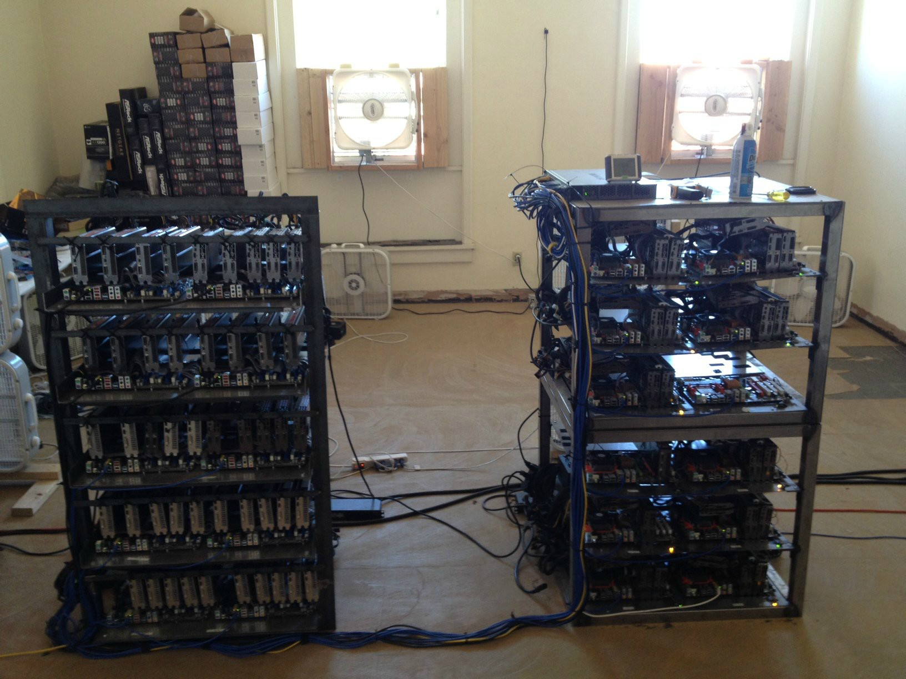
Source: LeonardH,
cryptocurrenciestalk.com

Slide 19
GPU mining disadvantages
poor utilization of hardware
poor cooling
large power draw
few boards to hold multiple GPUs
Instead of time-to-find-block, compare to a lottery. What’s the chance of finding one in day?
Throughput on a good card = 20-200 MHz ≈ 2²⁷
≈173 years to find a block w/100 cards!

Slide 20
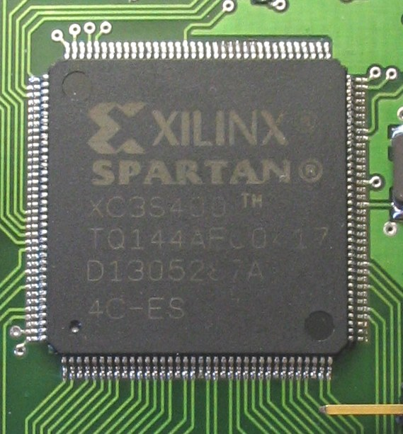
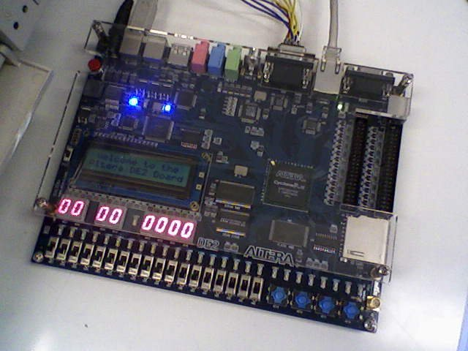
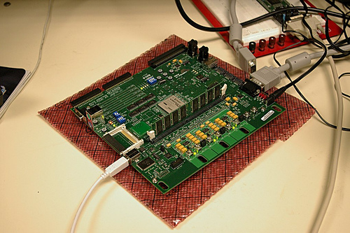
FPGA mining
Field Programmable Gate Area
First used for Bitcoin ca. June 2011
Implemented in Verilog

Slide 21
FPGA mining advantages
higher performance than GPUs
excellent performance on bitwise operations
better cooling
extensive customisation, optimisation

Slide 22
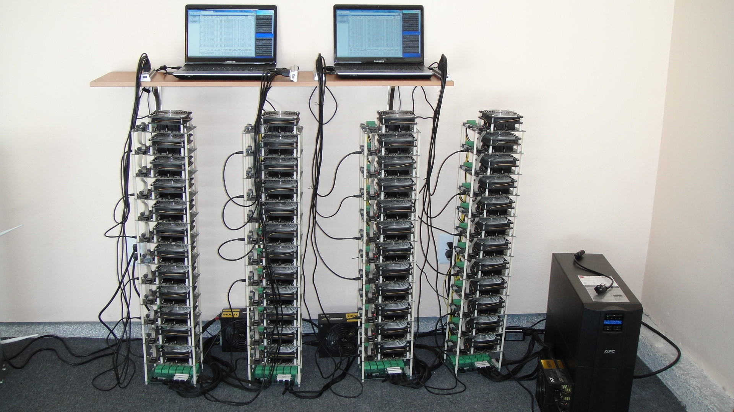
Bob Buskirk, thinkcomputers.org

Slide 23
FPGA mining disadvantages
higher power draw than GPUs designed for
frequent malfunctions, errors
poor optimization of 32-bit adds
fewer hobbyists with sufficient expertise
more expensive than GPUs
marginal performance/cost advantage over GPUs
Throughput on a good card = 100-1000 MHz ≈ 2³⁰
25 years to find a block w/100 boards!

Slide 24

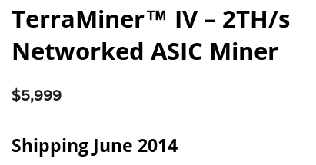
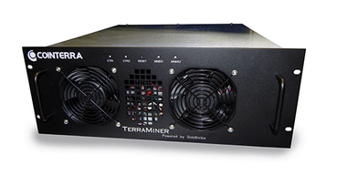
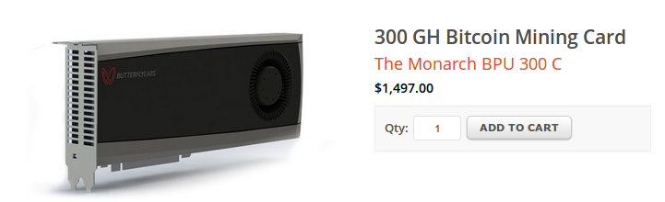
Bitcoin ASICs

Slide 25
Bitcoin ASICs
special purpose
approaching known limits on feature sizes
less than 10x performance improvement expected
designed to be run constantly for life
require significant expertise, long lead-times
perhaps the fastest chip development ever!

Slide 26
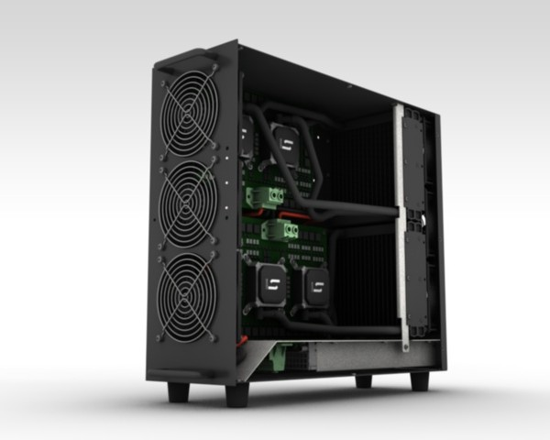
Case study: TerraMiner IV
First shipped Jan 2014
2 TH/s
Cost: US$6,000
Still, 14 months to find a block!

Slide 27
Market dynamics (2013/2014)
Most boards obsolete within 3-6 months
Half of profits made in first 6 weeks
Shipping delays are devastating to customers
Most companies require pre-orders
Most individual customers should have lost...
But... rising prices have saved them!

Slide 28
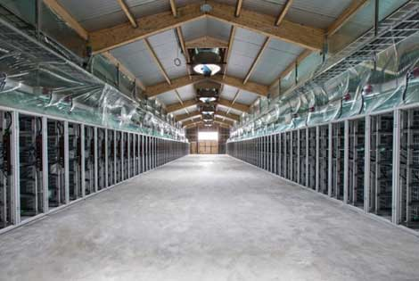
Professional mining centers
Needs:
cheap power
good network
cool climate
BitFury mining center, Republic of Georgia

Slide 29
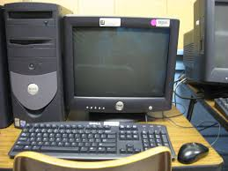
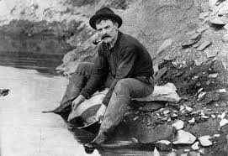
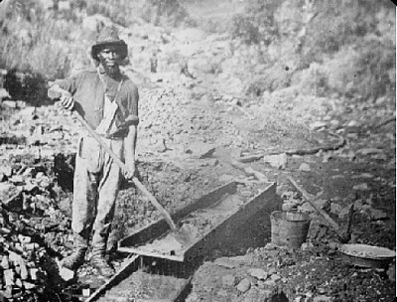
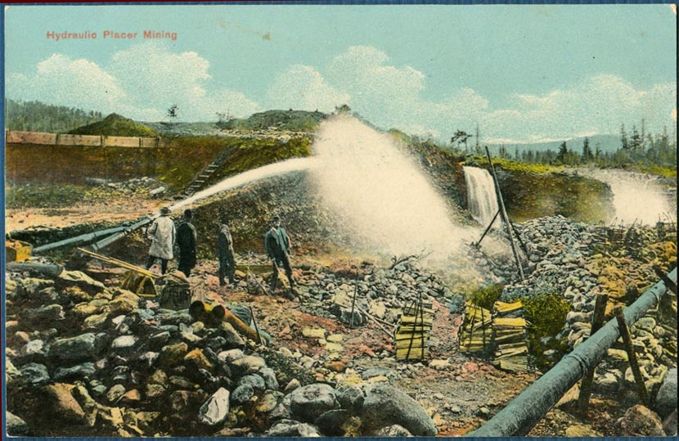
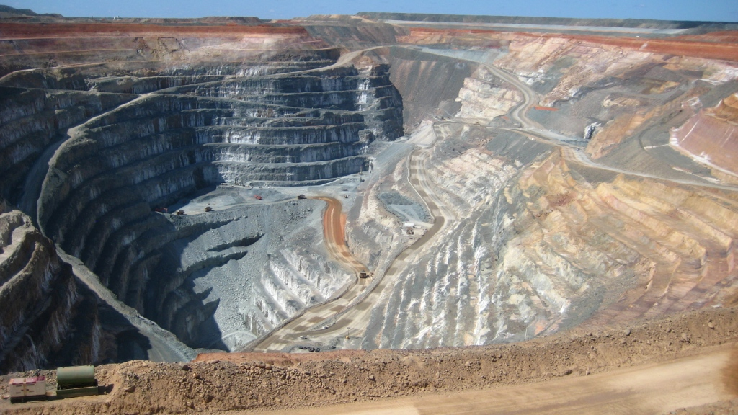
Evolution of mining
CPU GPU FPGA ASIC
gold pan sluice box placer mining pit mining

Slide 30
The future
Can small miners stay in the game?
Do ASICs violate the original Bitcoin vision?
Would we be better off without ASICs?
Stay tuned for our lecture on alt-mining!

Slide 31
Energy consumption & ecology

Slide 32
Thermodynamic limits
Landauer’s principle: Any non-reversible computation must consume a minimum amount of energy.
Specifically, each bit changed requires (kT ln 2) joules
SHA-256 is not reversible
Energy consumption is inevitable

Slide 33
Energy aspects of Bitcoin mining
Embodied energy: used to manufacture mining chips & other equipment
should decrease over time
returns to scale
Electricity: used to perform computation
should increase over time
returns to scale
Cooling: required to protect equipment
costs more with increased scale!

Slide 34
Estimating energy usage: top-down
Each block worth approximately US$15,000
Approximately $25/s generated
Industrial electricity (US): $0.03/MJ
$0.10/kWh
Upper bound on electricity consumed:
900 MJ/s = 900 MW

Slide 35
Estimating energy usage: bottom-up
Best claimed efficiency: 1 GHz/W
Network hash rate: 150,000,000 GHz
(excludes cooling, embodied energy)
Lower bound on electricity consumed:
150 MW

Slide 36
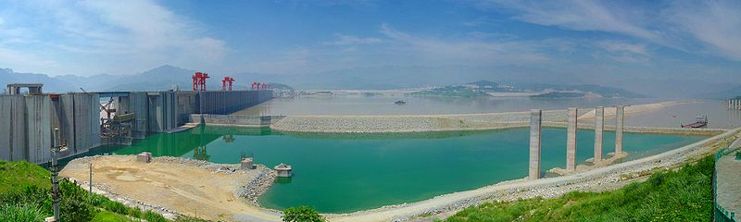
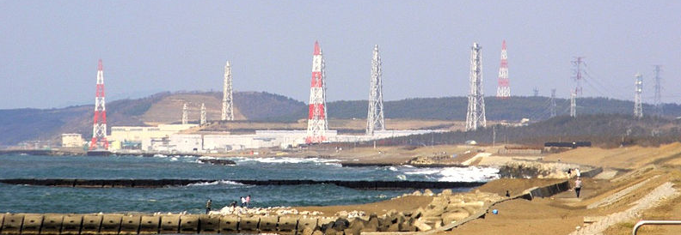
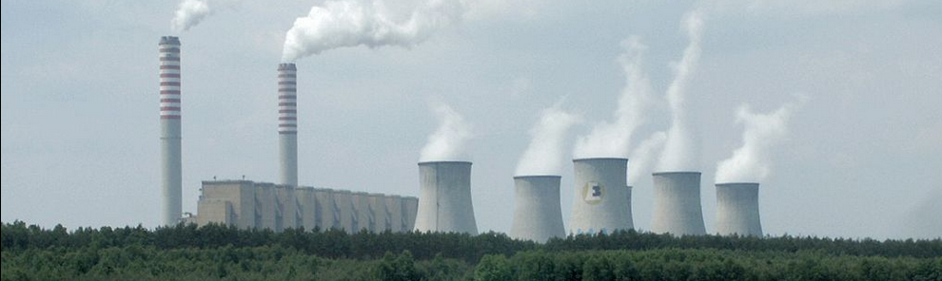
How much is a MW?
Three Gorges Dam = 10,000 MW
typical hydro plant ≈ 1,000 MW
Kashiwazaki-Kariwa
nuclear power plant = 7,000 MW
typical nuclear plant ≈ 4,000 MW
major coal-fired plant ≈ 2,000 MW

Slide 37
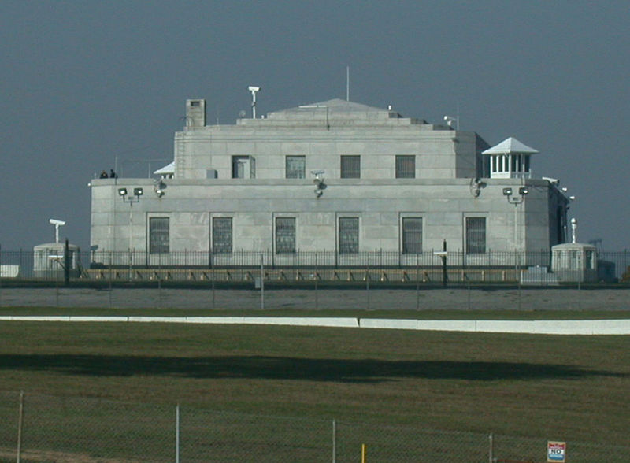
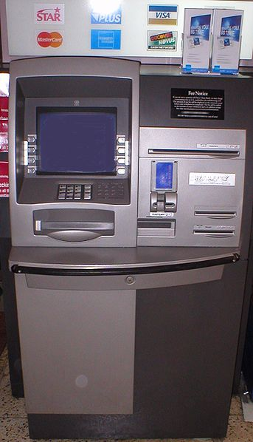
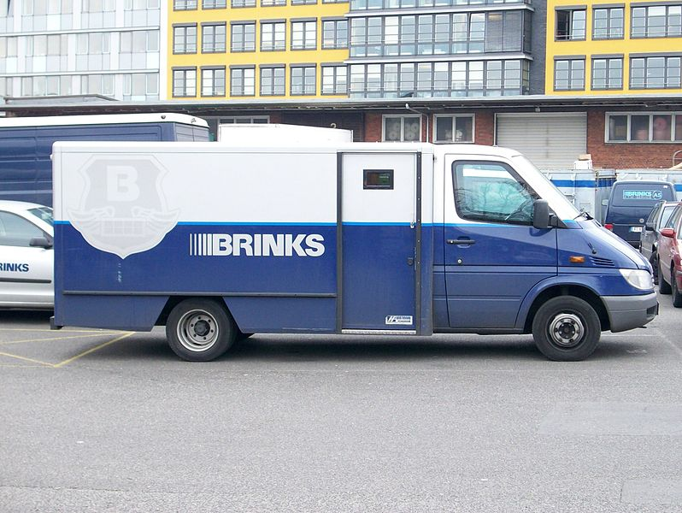
All payment systems require energy

Slide 38
Data furnaces
Observation: in the limit, computing devices produce heat almost as well as electric heaters!
Why not install mining rigs as home heaters?
Challenges:
Ownership/maintenance model
Gas heaters still at least 10x more efficient
What happens in summer?

Slide 39
Open questions
Will Bitcoin drive out electricity subsidies?
Will Bitcoin require guarding power outlets?
Can we make a currency with no proof-of-work?
Stay tuned for our lecture on alt-mining!

Slide 40
Mining pools

Slide 41
Economics of being a small miner
Cost: ≈US$6,000
Expected time to find a block: ≈14 months
Expected revenue: ≈$1,000/month
TerraMiner IV

Slide 42
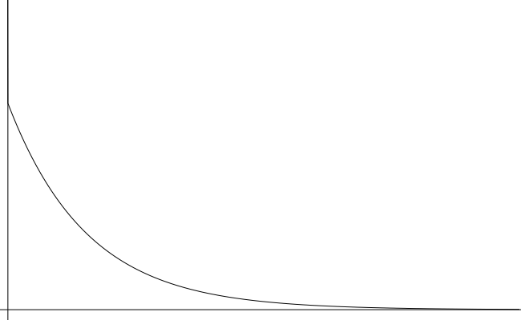
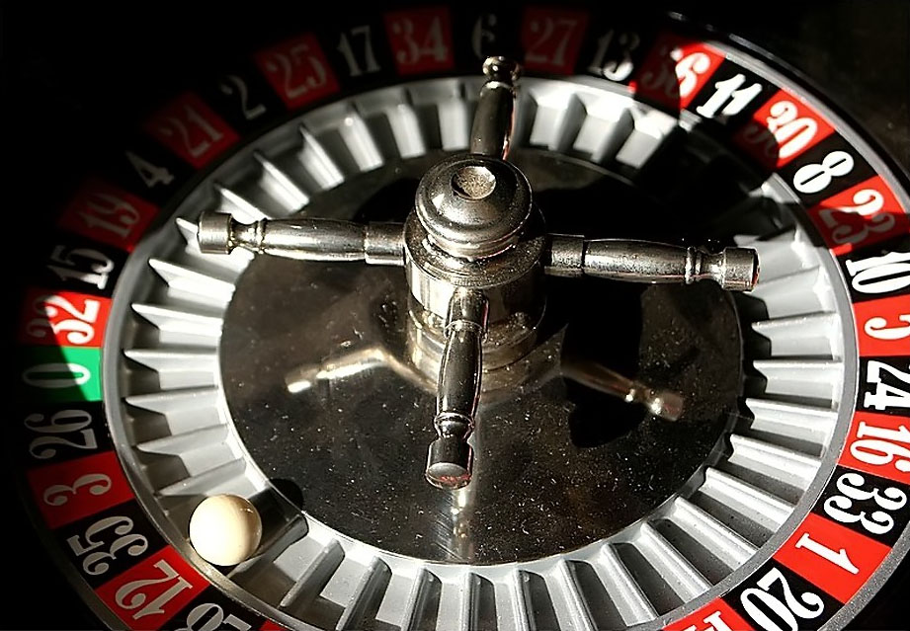
Mining uncertainty
# blocks found in one year | probability (Poisson dist.)
0 | 42.4%
1 | 36.4%
2 | 15.6%
3+ | 5.6%
14
months
Probability density
Time to find first block

Slide 43

Idea: could small miners pool risk?

Slide 44
Mining pools
Goal: pool participants all attempt to mine a block with the same coinbase recipient
send money to key owned by pool manager
Distribute revenues to members based on how much work they have performed
minus a cut for pool manager
How do we know how much work members perform?

Slide 45
Mining shares
Idea: prove work with “near-valid blocks” (shares)
4AA087F0A52ED2093FA816E53B9B6317F9B8C1227A61F9481AFED67301F2E3FB
D3E51477DCAB108750A5BC9093F6510759CC880BB171A5B77FB4A34ACA27DEDD
00000000008534FF68B98935D090DF5669E3403BD16F1CDFD41CF17D6B474255
BB34ECA3DBB52EFF4B104EBBC0974841EF2F3A59EBBC4474A12F9F595EB81F4B
00000000002F891C1E232F687E41515637F7699EA0F462C2564233FE082BB0AF
0090488133779E7E98177AF1C765CF02D01AB4848DF555533B6C4CFCA201CBA1
460BEFA43B7083E502D36D9D08D64AFB99A100B3B80D4EA4F7B38E18174A0BFB
000000000000000078FB7E1F7E2E4854B8BC71412197EB1448911FA77BAE808A
652F374601D149AC47E01E7776138456181FA4F9D0EEDD8C4FDE3BEF6B1B7ECE
785526402143A291CFD60DA09CC80DD066BC723FD5FD20F9B50D614313529AF3
000000000041EE593434686000AF77F54CDE839A6CE30957B14EDEC10B15C9E5
9C20B06B01A0136F192BD48E0F372A4B9E6BA6ABC36F02FCED22FD9780026A8F

Slide 46
Hey folks! Here’s our next block to work on
Mining pools
Pool manager
prev: H( )
mrkl_root: H( )
coinbase:
25→pool
$$$
nonce:
hash:
$$
0x00000000000a877902e...
$
0x000000000001e8709ce...
0x00000000000000003f89...
0x00000000000490c6b00...
0x0000000000007313f89...
0x0000000000045a1611f...

Slide 47
Mining pool variations
Pay per share: flat reward per share
Typically minus a significant fee
What if miners never send in valid blocks?
Proportional: typically since last block
Lower risk for pool manager
More work to verify
“Luke-jr” approach: no management fee
Miners can only get paid out in whole BTC
Pool owner keeps spread

Slide 48
Mining pool protocols
API for fetching blocks, submitting shares
Stratum
Getwork
Getblockshare
Proposed for standardization with a BIP
Increasingly important; some hardware support

Slide 49
Mining pool history
First pools appear in late-2010
Back in the GPU era!
By 2014: around 90% of mining pool-based
June 2014: GHash.io exceeds 50%

Slide 50
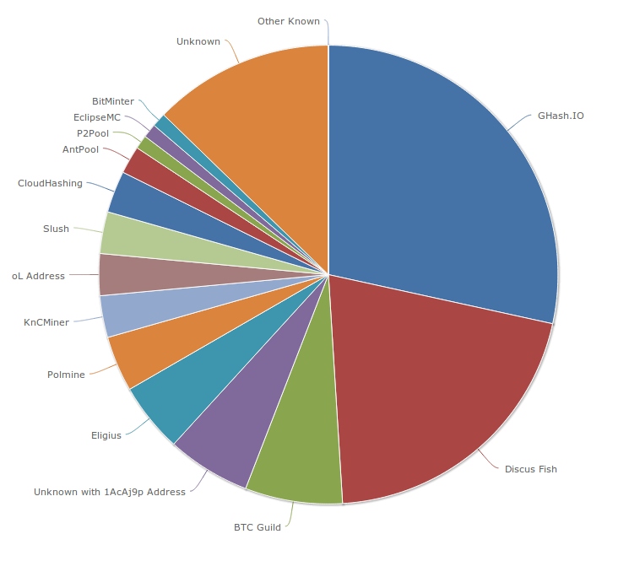
Mining pools (as of August 2014)

Slide 51
Are mining pools a good thing?
Pros
Make mining more predictable
Allow small miners to participate
More miners using updated validation software
Cons
Lead to centralization
Discourage miners from running full nodes
Can we prevent pools?
Stay tuned for our lecture on alt-mining!

Slide 52
Mining Incentives and Strategies

Slide 53
Game-theoretic analysis of mining
Several strategic decisions
Which transactions to include in a block
Default: any above minimum transaction fee
Which block to mine on top of
Default: longest valid chain
How to choose between colliding blocks
Default: first block heard
When to announce new blocks
Default: immediately after finding them

Slide 54
Game-theoretic analysis of mining
Assume you control 0 < α < 1 of mining power
Can you profit from a non-default strategy?
For some α, YES, though analysis is ongoing!

Slide 55
Forking attacks
M→M’
M→M’
M→B
M→B

Slide 56
Forking attacks
Certainly possible if α >0.5
may be possible with less
avoid block collisions
Attack is detectable
Might be reversed
Might crash exchange rate

Slide 57
Forking attacks via bribery
Idea: building α > 0.5 is expensive. Why not rent it instead?
Payment techniques:
Out-of-band bribery
Run a mining pool at a loss
Insert large “tips” in the block chain
This is an open problem!

Slide 58
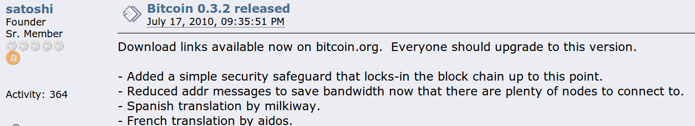
Checkpointing
Default clients ship with built-in checkpoint

Slide 59
Block-withholding attacks
Strategy: don’t announce blocks right away. Try to get ahead!
“Selfish mining”
Secret Block
Secret Block
All other miners are wasting effort here!

Slide 60

Block-withholding attacks, take 2
What happens if a block is announced when you’re ahead by 1?
Secret Block
The race is on!

Slide 61
Block-withholding attacks
Improved strategy for any α if you can win every race
Ideal network position
Bribery?
With a 50% chance of winning races, improved strategy for α > 0.25
Not yet observed in practice!
Surprising departure from previous assumptions

Slide 62
Punitive forking
Suppose you want to blacklist transactions from address X
Freeze an individual’s money forever
Extreme strategy: announce that you will refuse to mine on any chain with a transaction from X
With α < 0.5, you’ll soon fall behind the network

Slide 63
Feather-forking strategy
To blacklist transactions from X, announce that you will refuse to mine directly on any block with a transaction from X
but you’ll concede after n confirming blocks
Chance of pruning an offending block is α²

Slide 64
Response to feather forking
For other miners, including a transaction from X induces an α² chance of losing a block
Might be safer to join in on the blacklist
Can enforce a blacklist with α < 0.5!
Success depends on convincing other miners you’ll fork

Slide 65
Feather-forking: what is it good for?
Freezing individual bitcoin owners
ransom/extortion
law enforcement?
Enforcing a minimum transaction fee...

Slide 66
A second look at transaction fees
Default policy:
priority = sum(input_value * input_age)/size_in_bytes
?
Accept without fees if:
priority > 0.576

Slide 67
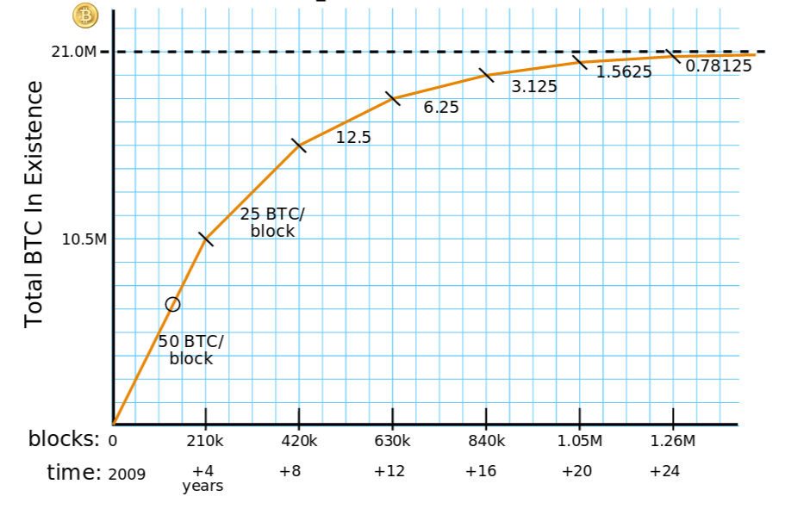
Transaction fees will matter more
Currently, block rewards are > 99% of miner revenue. But:
Eventually, transaction fees will dominate
Courtesy:
Brian Warner

Slide 68
Will miners cooperate to enforce fees?

Slide 69
Bribery attacks
Start a new mining pool paying 25+ε
Guarantee payment instead of dividing up wins
Mutual trust issues
Pay miners directly
Potentially cheaper
Trust/information issues
Kickbacks
Solve some trust issues
Complicated technically

Slide 70
Summary
Miners are free to implement any strategy
Very little non-default behavior in the wild
No complete game-theoretic model exists
Things might be about to get interesting...

Slide 71
In the next lecture...

Slide 72
How much anonymity does Bitcoin provide?

